Slide 1
Differences Between DFA and NFA (or NDFA)
DFA- no null moves, whereas NFA may consists of null moves
It is possible to reach only one output state using same source state and same input symbol in DFA; where as in NFA, it is possible to reach one or more than one output states using same source state and same input symbol
3. Syntax of DFA, M = { Q, Σ, δ ,q, F, }, where , Q : Finite set
of states, Σ : set of Input Symbols, δ : Transition Mapping
Function, Q X (Σ U ε ) --> 2 ^ Q, q : Initial state.
Syntax of Non-Deterministic Finite Automata M = { Q, Σ, δ
,q, F, }. Q : Finite set of states, Σ : set of Input Symbols,
δ : Transition Mapping Function, Q X (Σ U ε ) --> 2 ^ Q,
q : Initial state, F : set of Final States.

Slide 2
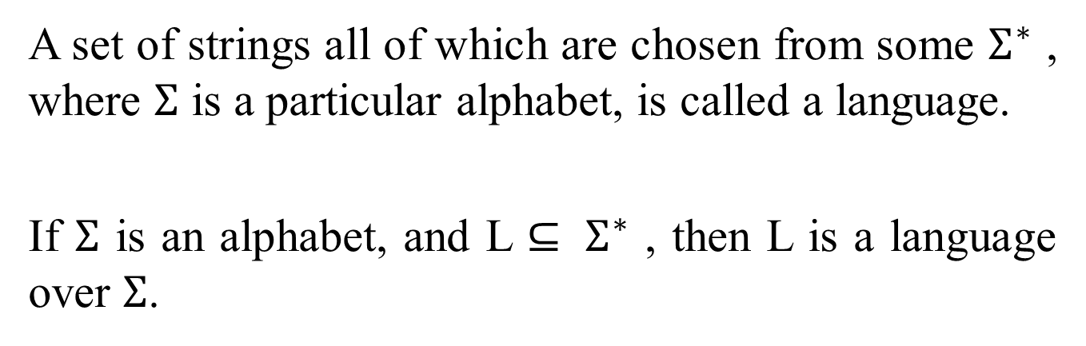
Language
A set of strings all of which are chosen from some $Σ^{∗}$ , where $Σ$ is a particular alphabet, is called a language.
If $Σ$ is an alphabet, and L $⊆ Σ^{∗}$ , then L is a language over $Σ$.

Slide 3
How a DFA Processes Strings
How the DFA decides whether or not to accept a sequence of input symbols
The language of the DFA is the set of all strings that the DFA accepts

Slide 4
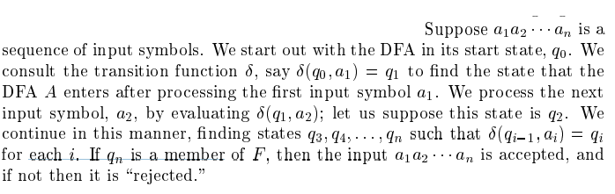

Slide 5
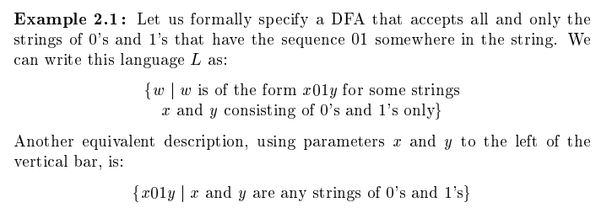

Slide 6
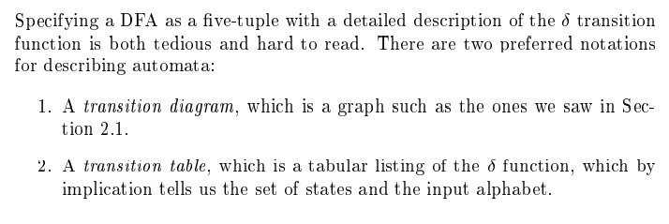
Simpler Notations of DFA

Slide 7
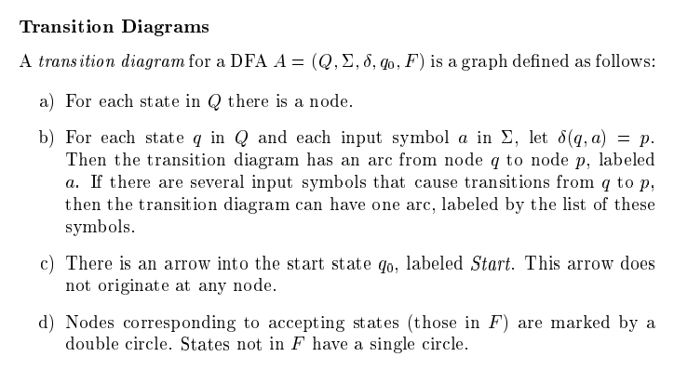
Simpler Notations of DFA

Slide 8
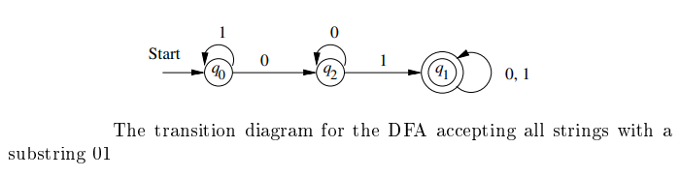
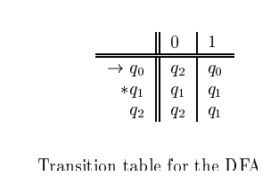
Simpler Notations of DFA

Slide 9
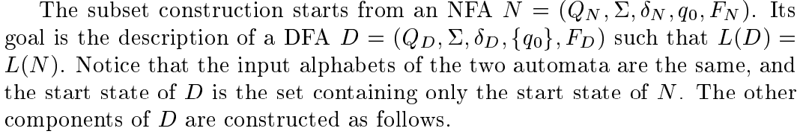

Equivalence of DFA and NFA

Slide 10
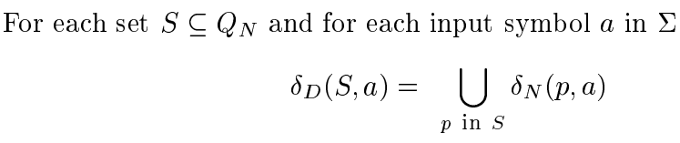
Equivalence of DFA and NFA

Slide 11
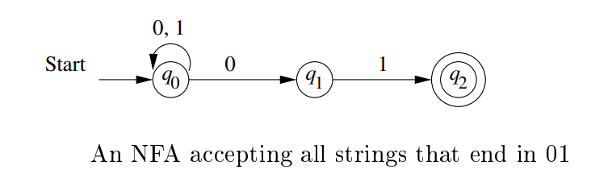
Equivalence of DFA and NFA : Example

Slide 12
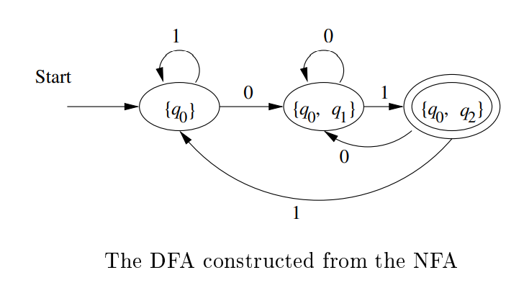
Equivalence of DFA and NFA : Example

Slide 13
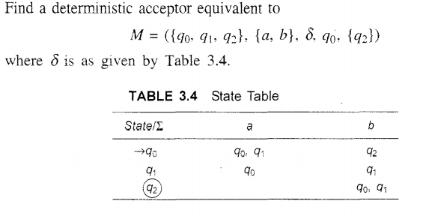
Equivalence of DFA and NFA : Example

Slide 14
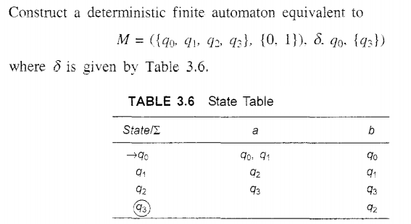
Equivalence of DFA and NFA : Example

Slide 15
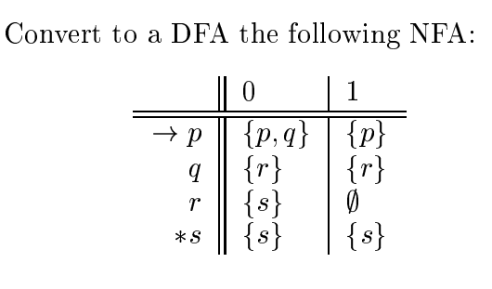
Equivalence of DFA and NFA : Example

Slide 16
Equivalence of DFA and NFA : Example
Give DFA's accepting the following languages over the alphabet {0,1}
Give DFA's accepting the following languages over the alphabet {0,1}
the set of all strings ending in 00
the set of all strings with three consecutive 0's
the set of all strings with 011 as a substring
the set of all strings with 110 as a substring
the set of all string with 101 as substring
the set of all strings ending in 101

